Slide 1
Web App tester

Slide 2
Submitted by:
Ritik Pratap Singh
Ritvik Tyagi
Ayush Jain
Submitted to:
Dr. Swathi J.N.

Slide 3
Objective
The main aim of the project is to provide a tool which can be helpful in testing other software and projects. The main objectives are to test the HTML errors in the web pages, test the CSS errors in the pages and to find the broken links by using the method of web crawler that searches all the links. We have also achieved in providing reports to our users which help them locate the error and correct them so that their software will function better.
Another objective of our project was to implement any Testing application because Testing is one of the more important activities in the umbrella activities of software engineering. It is also to test the software before providing to the users as the system is risk oriented and any mis-leading scenarios may cause the system to crash or the user might be unhappy and dissatisfied

Slide 4
Motivation
The main motivation to begin working on such a project started from the basic requirement of any software developer that is Testing. As we have mentioned in the objective, we are motivated to provide users faster methods to find errors in their projects and quickly locate and correct them.
Also, the other part of our motive was to provide a tool in study of Testing as it is an integral part of any software developed under any scope.

Slide 5
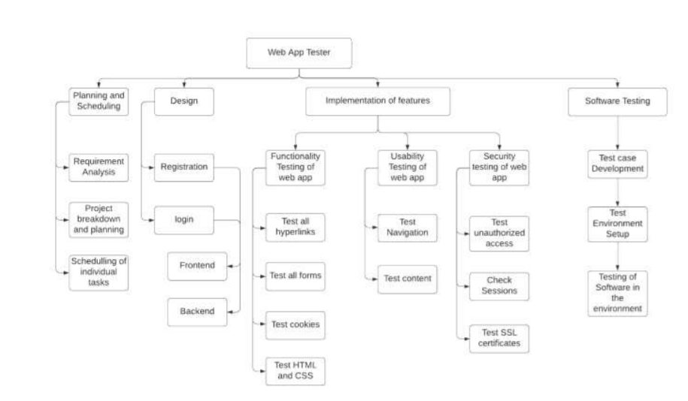
Work breakdown Structure

Slide 6
Process Model
We have selected the Spiral Model because of the following reasons:
As this is project involves new Technology which is new for us too and completely different than the other projects we did, therefore this model gives the time to explore each aspect our project correctly before moving on the other phase.
As our project intends to check the complete functional testing and other tests that will be checking how user friendly is the web app therefore, we intend to understand each requirement.
This model will enable our project to go through iterations necessary to ensure that our software performs properly and any bug is not left out and the client can identify and convey the changes required in our project.

Slide 7
System Attributes

Slide 8
Maintainability
The Web App tester is written in Python programming language. PYTHON promotes good design practices due to the inherent structure of a PYTHON program.
Along with the well-formed programming enforced by PYTHON, best practice development conventions will be enforced for the construction of the Web App tester. Consistent variable naming conventions will be used by all the programmers. Consistent spacing will be used in the source code by all the programmers. The design of the source code will use the principles of Object-Oriented Design and the source code will be programmed using Object Oriented Programming. Object-Oriented Design and Object-Oriented programming will make the code easier to understand.

Slide 9
Portability
It is safe to say that the implementation of the Web App tester will be able to be ported to other system platforms that accept PYTHON applications with little to no changes required. It is not safe to say that the Web App tester will execute properly on the other system platforms with little or no change. Significant changes to the Web App tester may be required to ensure proper execution on other system platform.

Slide 10
Security
The Web App tester will have login feature which will ensure that the privacy and data of the user is safe at all times. As the programming in which it is written is PYTHON, it ensures high security as PYTHON is famous for its secure code writing practices.

Slide 11
Reliability
Reliability in the Web App tester will be ensured by thorough unit, milestone, and release testing.
Comprehensive test scenarios and acceptance criteria will be established to reflect the necessary level reliability required of the Web App tester. The all delivered source code will be thoroughly tested using the established test scenarios until the acceptance criteria are satisfied by the Web App tester.

Slide 12
Design Approach and Details

Slide 13
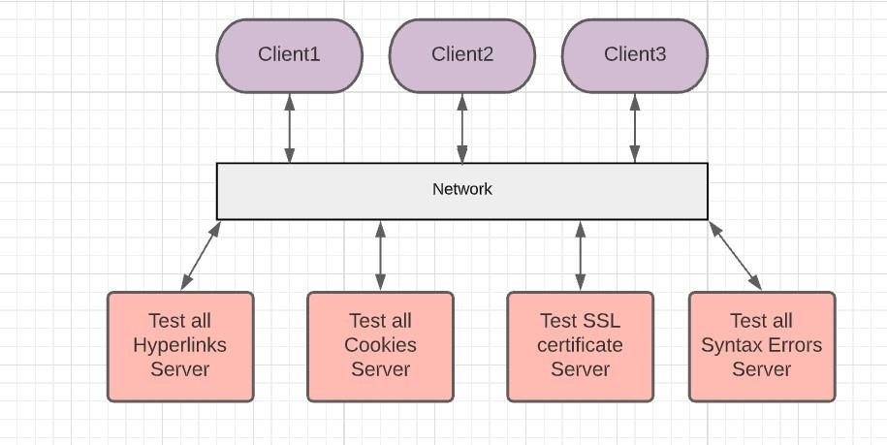
Architectural Diagram

Slide 14
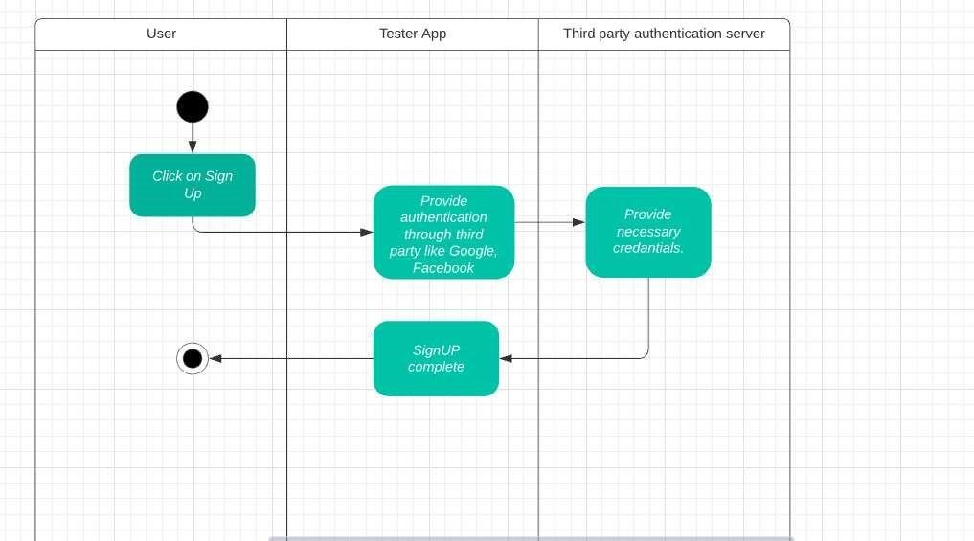
Swimlane Activity Diagram
Login Activity

Slide 15
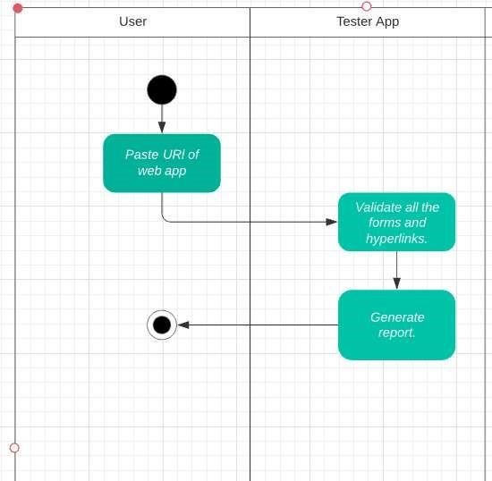
Swimlane Activity Diagram
Hyperlink Validation

Slide 16
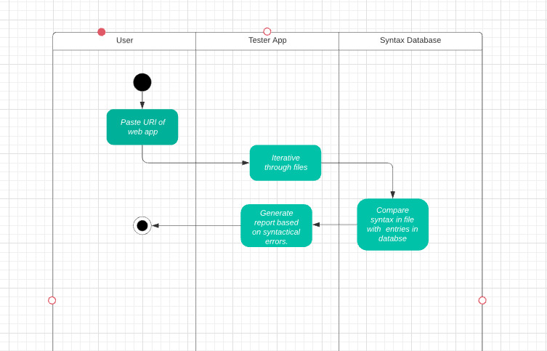
Swimlane Activity Diagram
HTML/CSS Errors

Slide 17
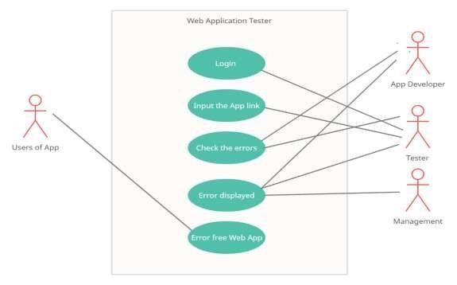
UseCase Diagram

Slide 18
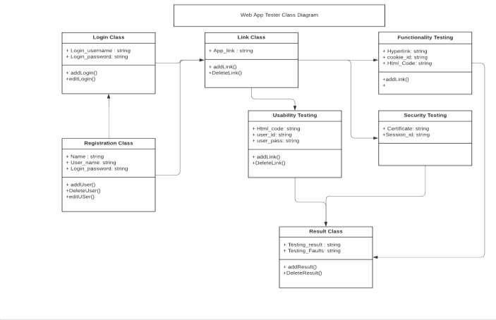
Class Diagram

Slide 19
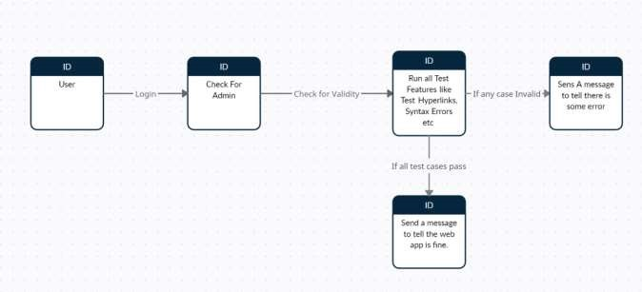
Data Flow Diagram

Slide 20
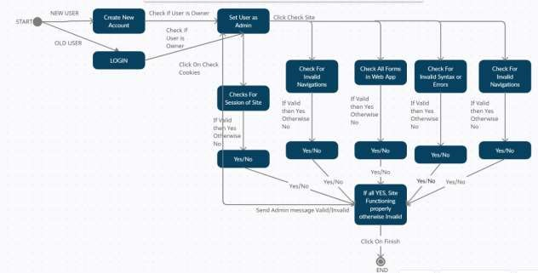
State Transition Diagram

Slide 21
Sequence And Collaboration

Slide 22
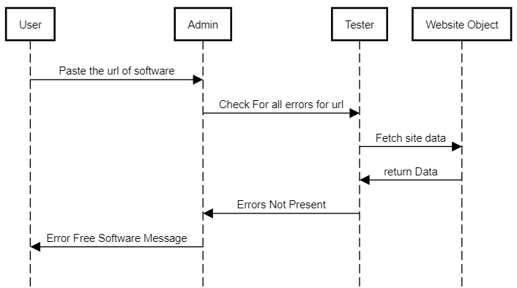
Bug Free Sequence Diagram

Slide 23
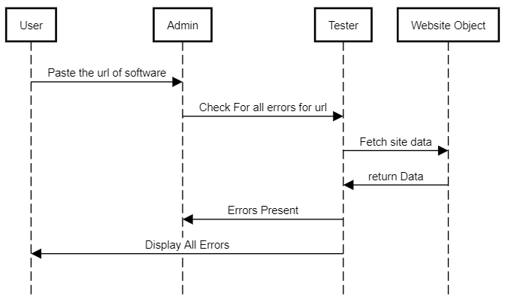
Error Sequence Diagram

Slide 24
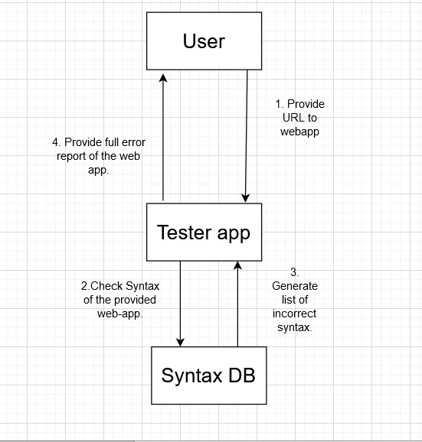
Collaboration Diagram
Checking Syntax Errors

Slide 25
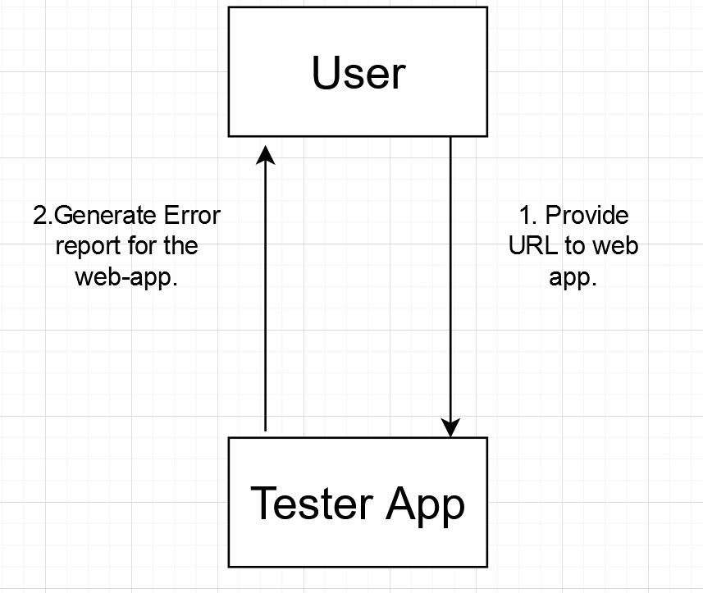
Collaboration Diagram
Generating test report

Slide 26
Schdules, Tasks And Milestones

Slide 27
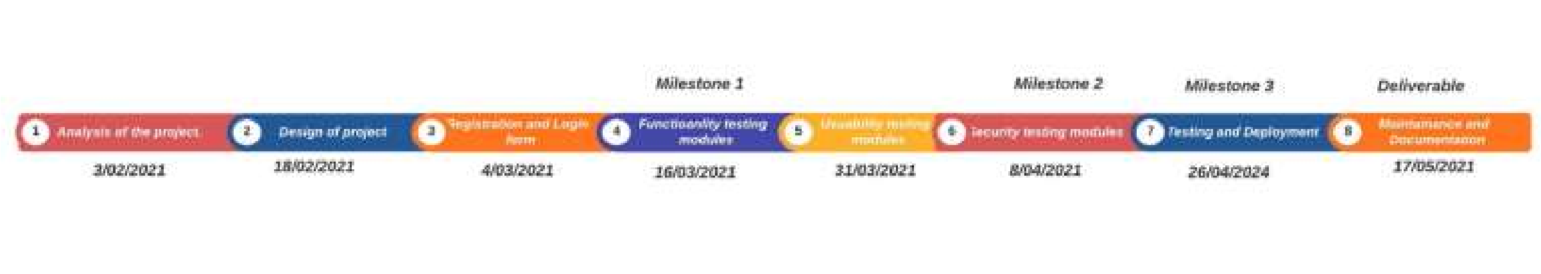
Timeline Chart

Slide 28
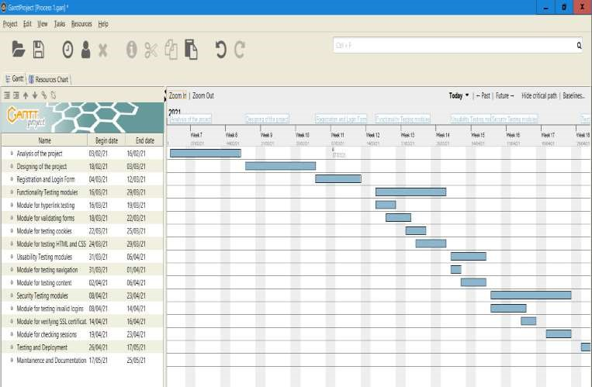
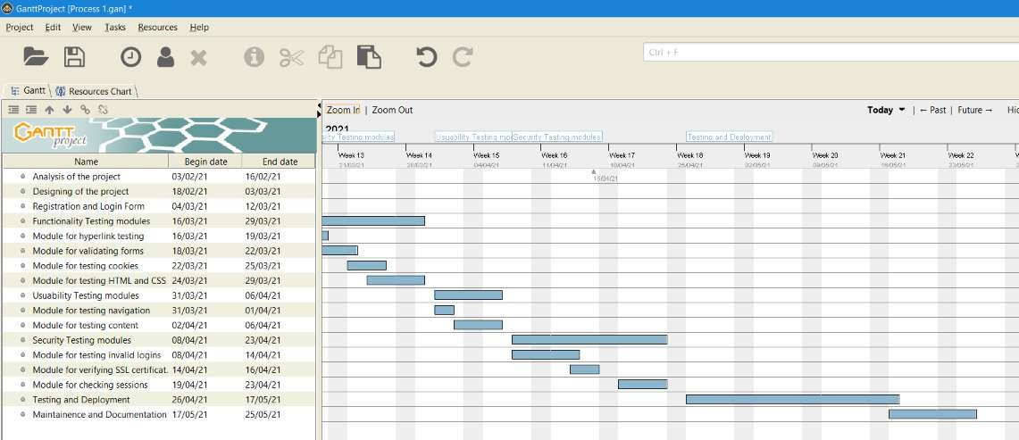
Product Gantt Chart

Slide 29
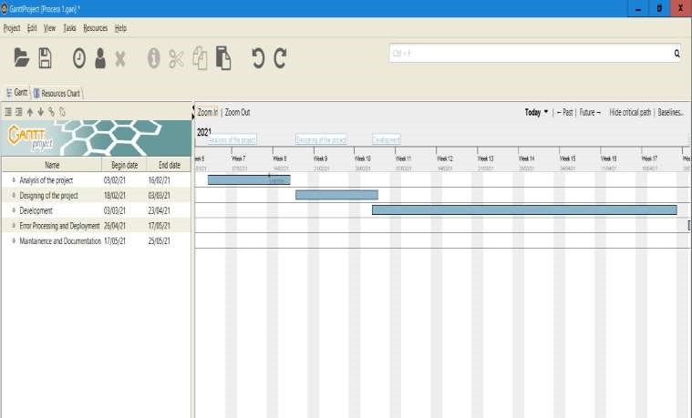
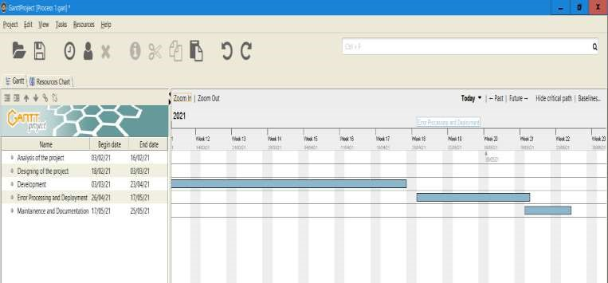
Process Gantt Chart

Slide 30
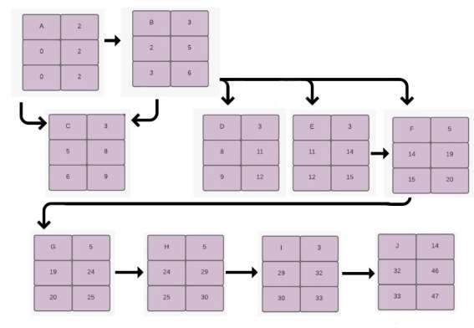
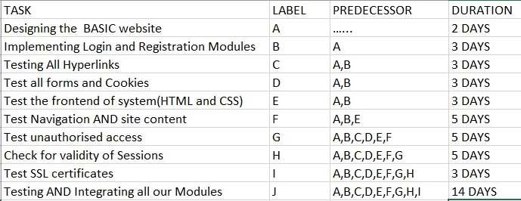
Activity Network Diagram
Product Based

Slide 31
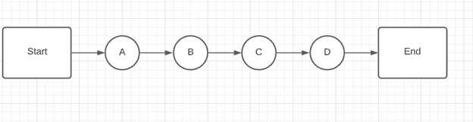
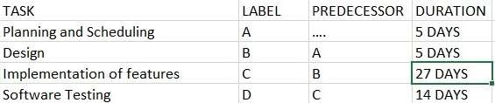
Activity Network Diagram
Process Based

Slide 32
GUI

Slide 33
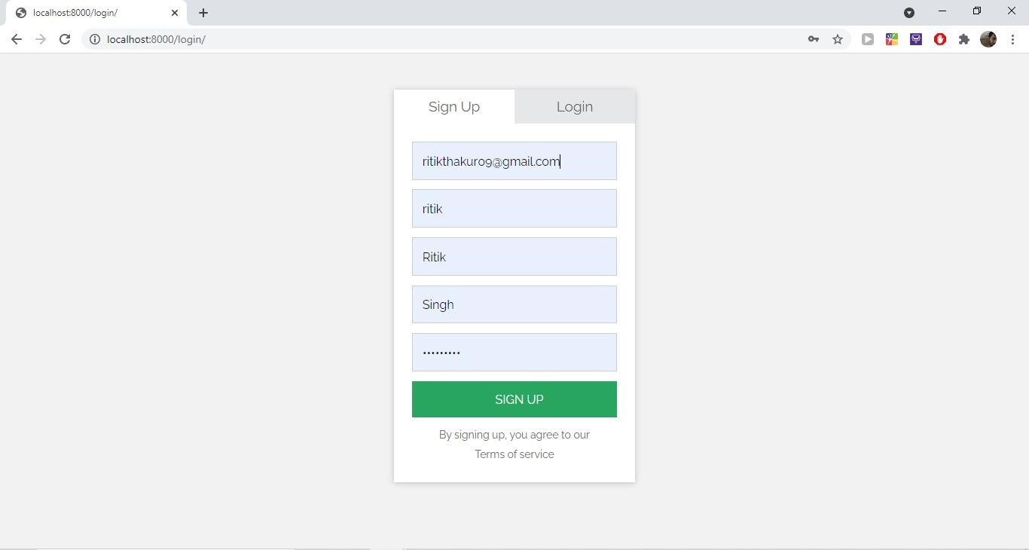
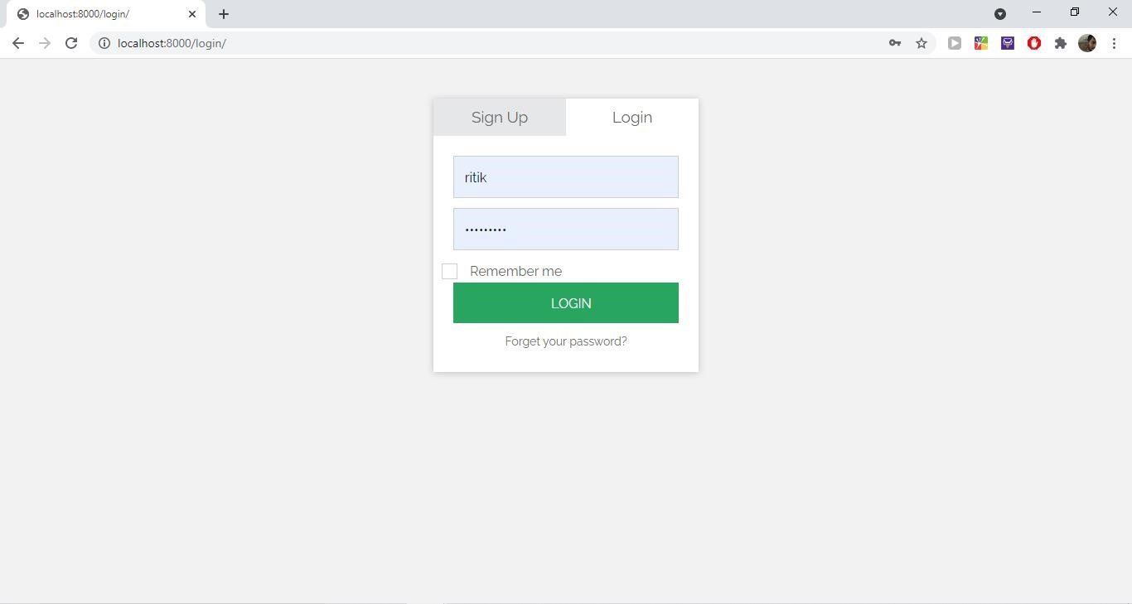
Signup/Login

Slide 34
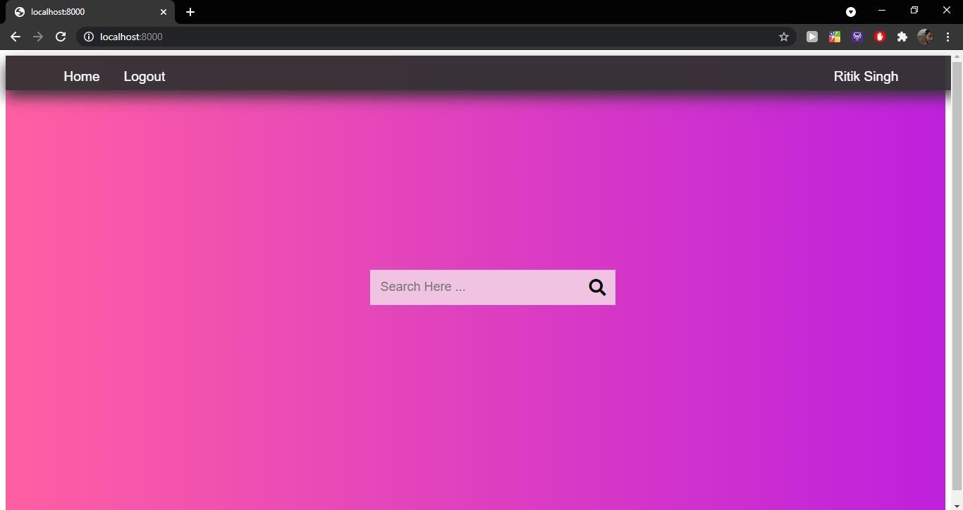
Homepage

Slide 35
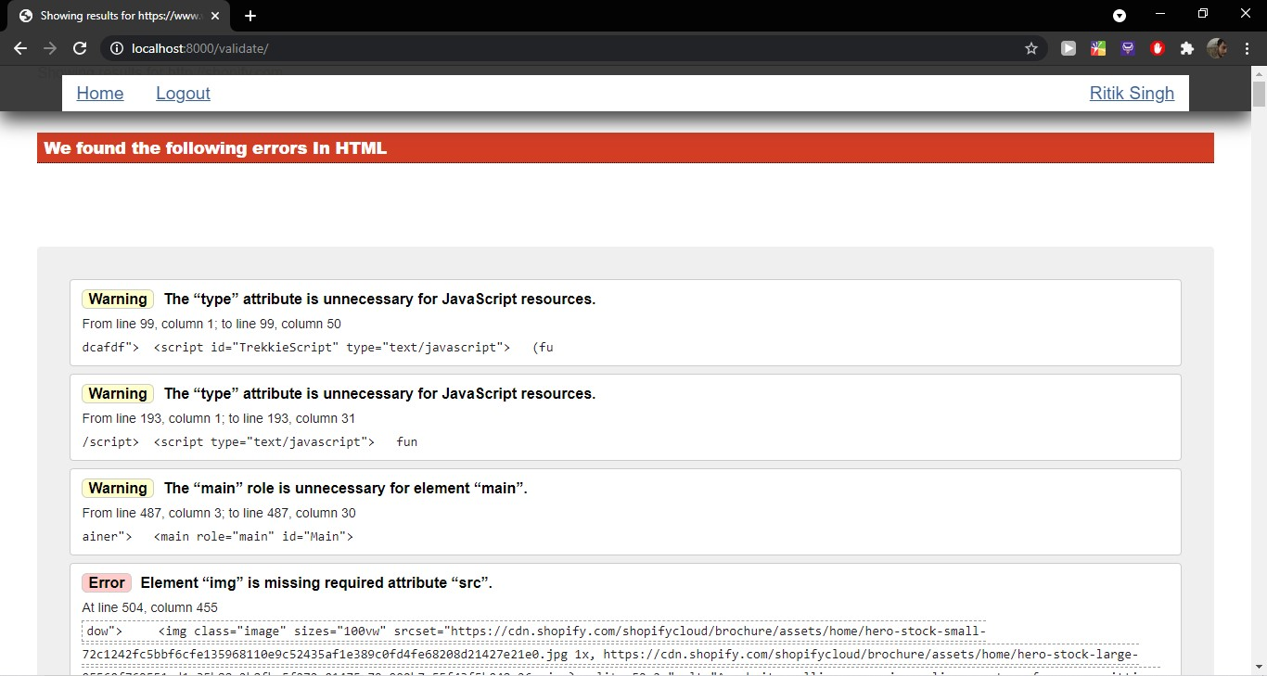
HTML Errors

Slide 36
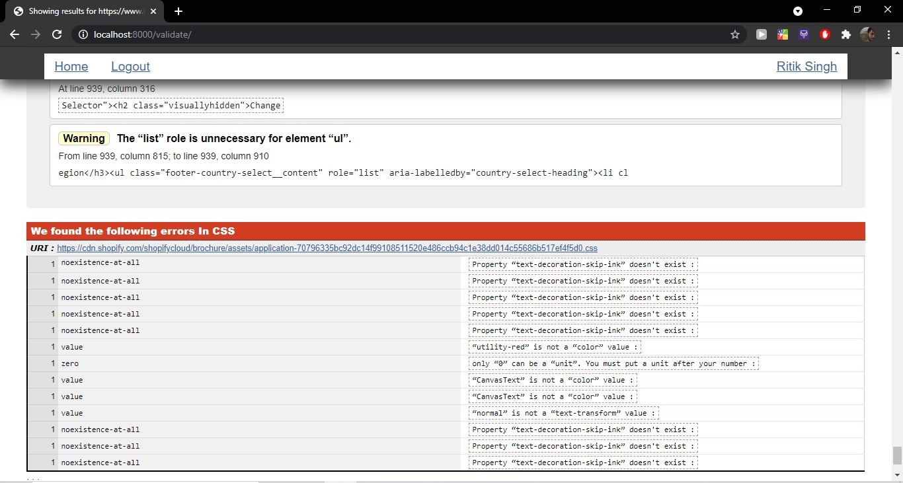
CSS Errors

Slide 37
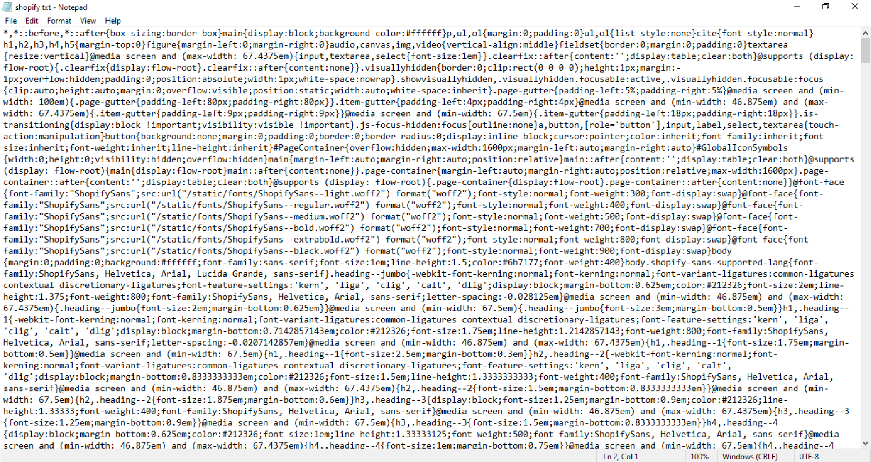
CSS Errors File

Slide 38
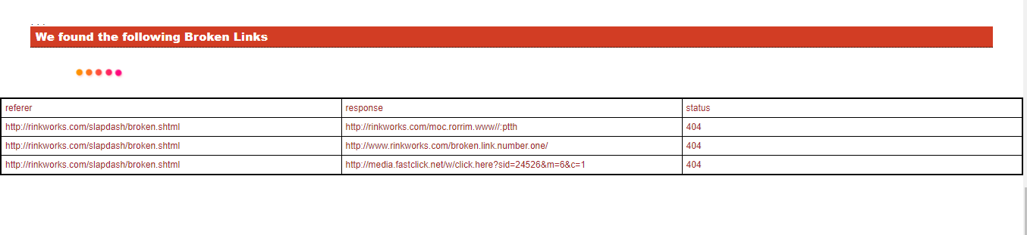
Broken Links

Slide 39
Results and Discussion
We have successfully created an autonomous Web App Tester to help the web App developers. We were successful in imparting a lot of functionalities into our project. Web App Tester will save web developers a lot of time as some of the tedious tasks like testing for functioning links will be automated.
We were not able to make an enterprise level tool because our limited resources at our hands and our inexperience in this technology. Future work includes adding Artificial Intelligence in to our project to catching not so obvious errors in the code and also to test navigation of the web app.

Slide 40
Thanks!

